Slide 1


BOOKING
Visual Programming
FLIGHT
TICKET
Berke Kadir Yıldırım
Büşra Soysal
Büşra Yaydemir
Emine Gelir
Mustafa Çakar

Slide 2
TABLE OF CONTENT
Introduction
General Structure
UI Designs
Database Design
Code Structure
Working Structure of the Program
Tests and Results
Conclusion

Slide 3
INTRODUCTION
The Booking Flight Ticket project aims to provide a convenient and reliable platform for users to book flights efficiently.

Slide 4

General Structure
Steps taken during development
Features of the platforms used and rationale behind their selection
Challenges encountered and solutions devised

Slide 5


UI Designs
UI designs focused on simplicity, clarity, and intuitive navigation to enhance the user experience.
Visual elements were carefully selected to attract users' attention and guide them through the booking process seamlessly.

Slide 6
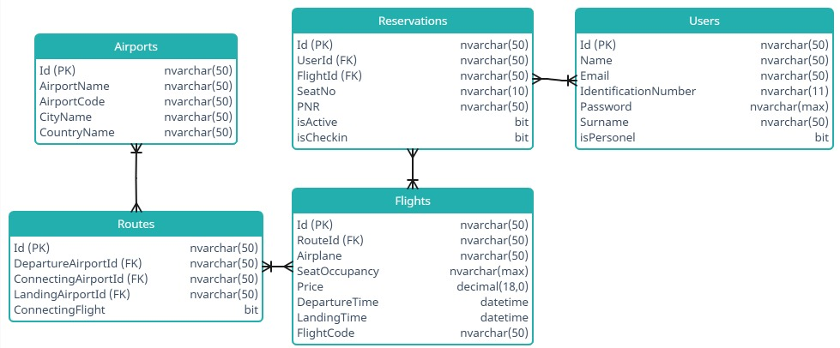
Database Design
MSSQL Server provides security, performance, and scalability.
The somee.com platform is utilized for hosting the MSSQL database.
The ER diagram visually represents the structure and relationships of the data.

Slide 7
Code Structure
The project is structured using the Model-View-Controller (MVC) architecture, with separate folders for models, views, and controllers.
Entity Framework is used for object-relational mapping (ORM) to interact with the MSSQL database.

Slide 8
Working Structure of the Program
Information about the operational framework of the booking flight ticket system and its user interaction dynamics.

Slide 9
Tests and Results
Testing methodologies include unit testing, integration testing, and user acceptance testing
Findings are documented through bug fixes to ensure the application meets quality standards.

Slide 10
Conclusion
The Booking Flight Ticket project successfully achieves its objectives of providing a convenient and reliable platform for booking flights.
Key accomplishments include implementing user-friendly UI designs, robust database management, and efficient code structure.

Slide 11
THANK YOU.

